Slide 1

WELCOME
Team 15 Pitch

Slide 2

1| Team
1 | Who are we?
Team number 15
Notes:
Hello, we are Team Turtles or Team 15 and we warmly welcome you to our pitch

Slide 3
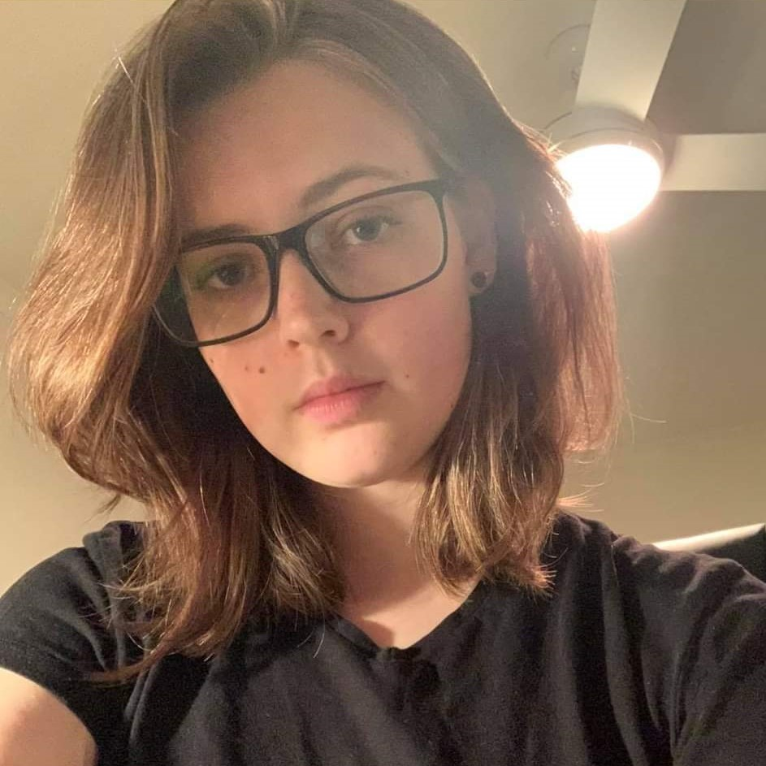
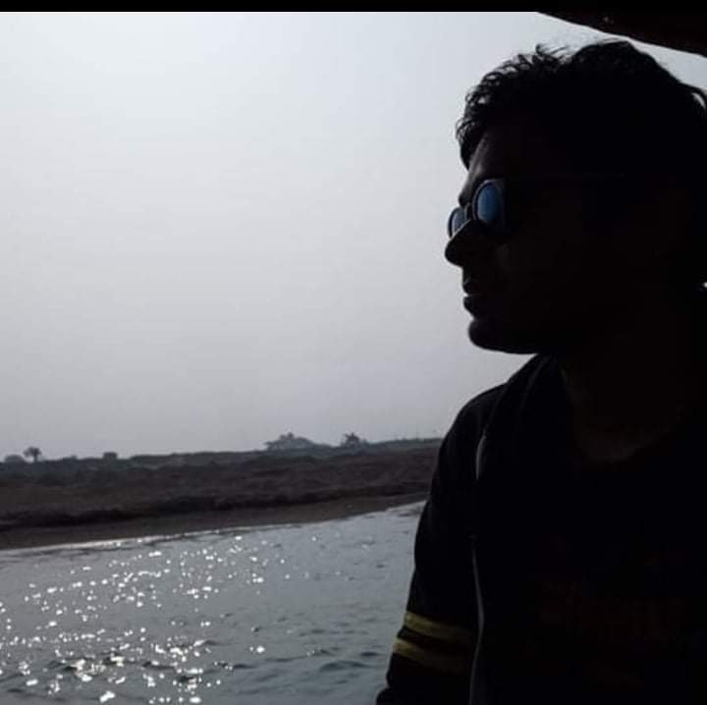
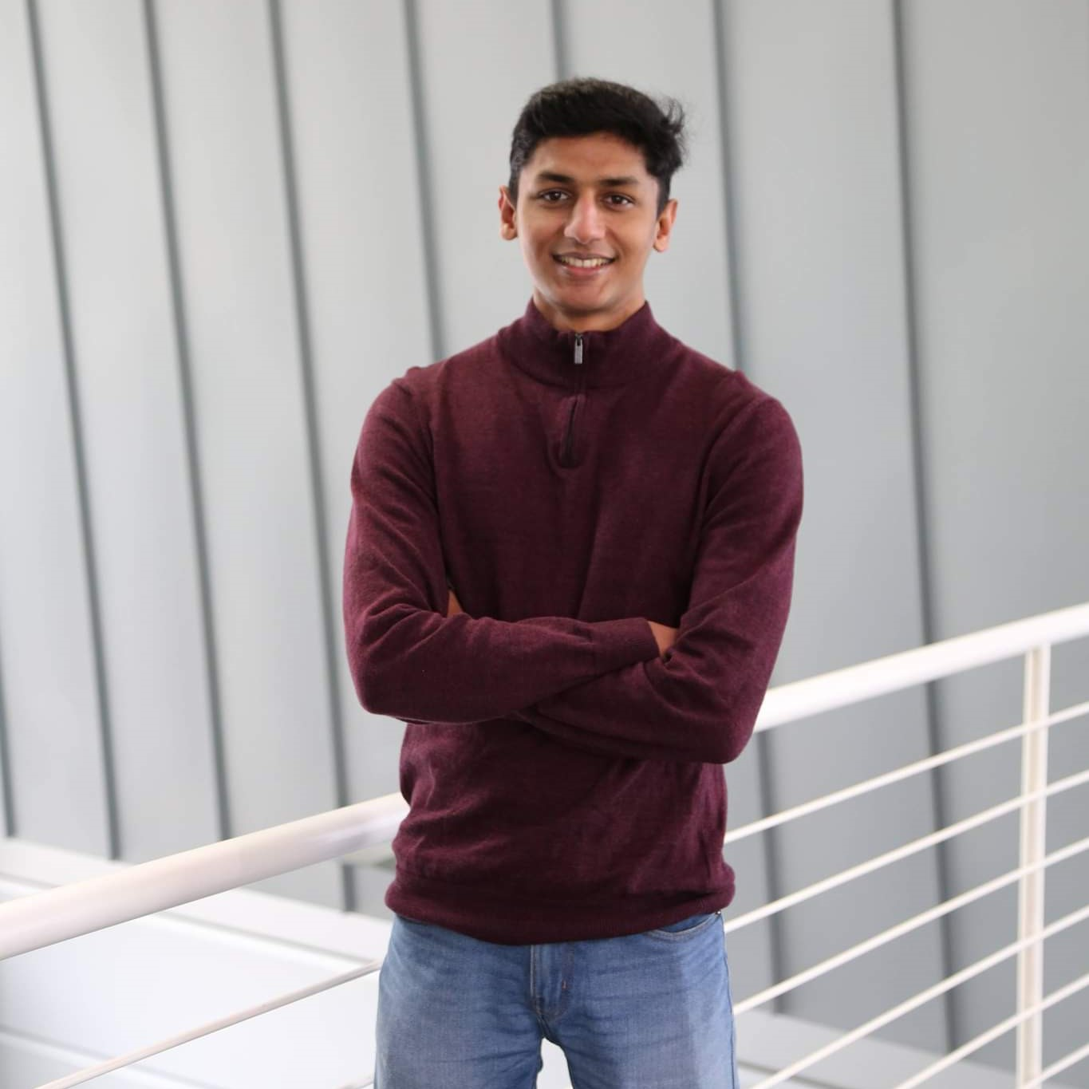

1| Team
1 | Members
Sarah Bao Ngoc
Fadal Farouk
Media and Graphics Design
Researcher
Brie Smith
Ragib Shaan
Team Leader
Researcher
Notes:
The team consists of Brie (who unfortunately would not be joining us today), Fadal, Ragib and Sara.

Slide 4
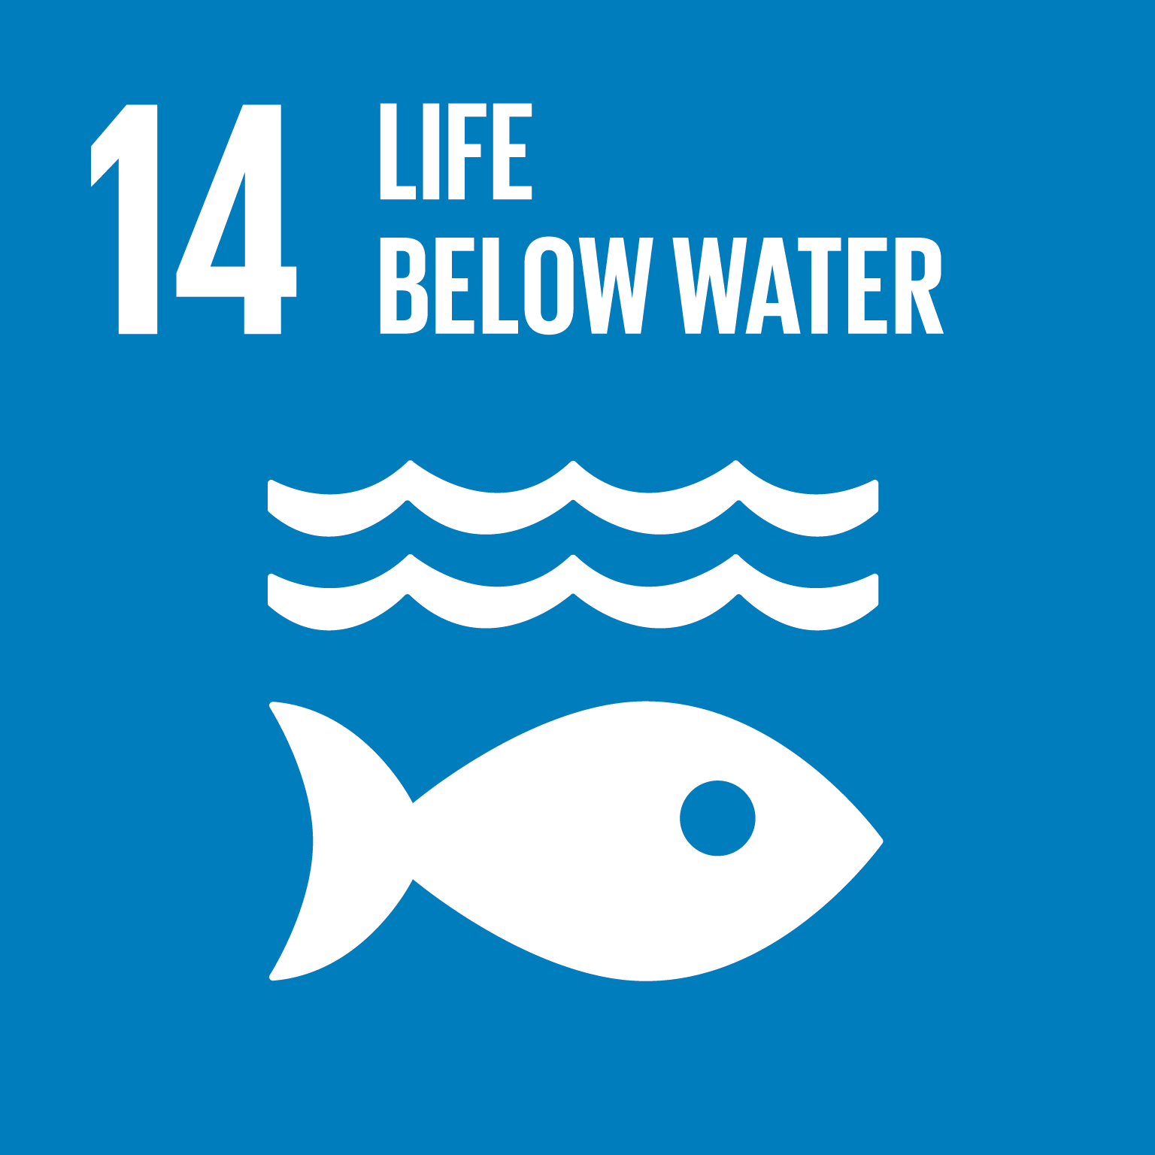

2| Problem
3 | The UNSDG we aim for
Goal 14 - Life Below Water
Goal 14 Target 14.1 - Significantly reduce plastic debris
Our target market: The youth (16-25) and individuals who strive for a sustainable future
Notes:
From the UNSDGs, we aim for Goal 14: Life Below Water
Target 14.1 - Significantly reduce plastic debris
Our target market are the young adults and teenagers
target market
So Our target market is
So Our target market is

Slide 5
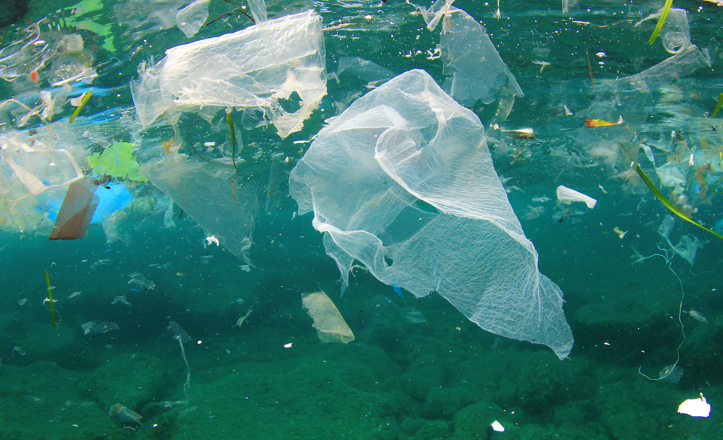
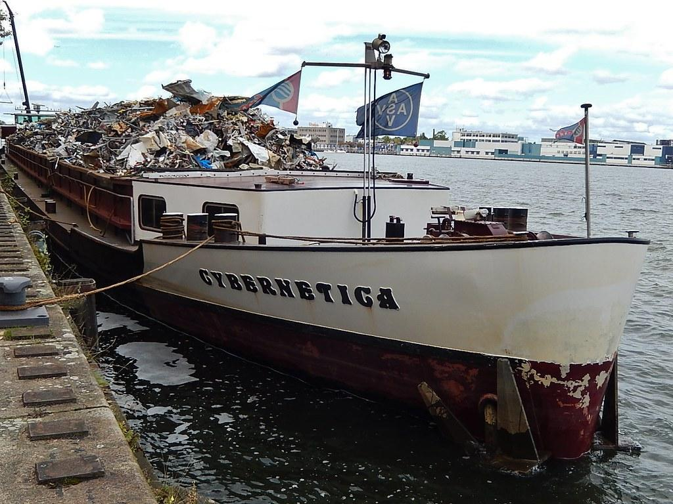
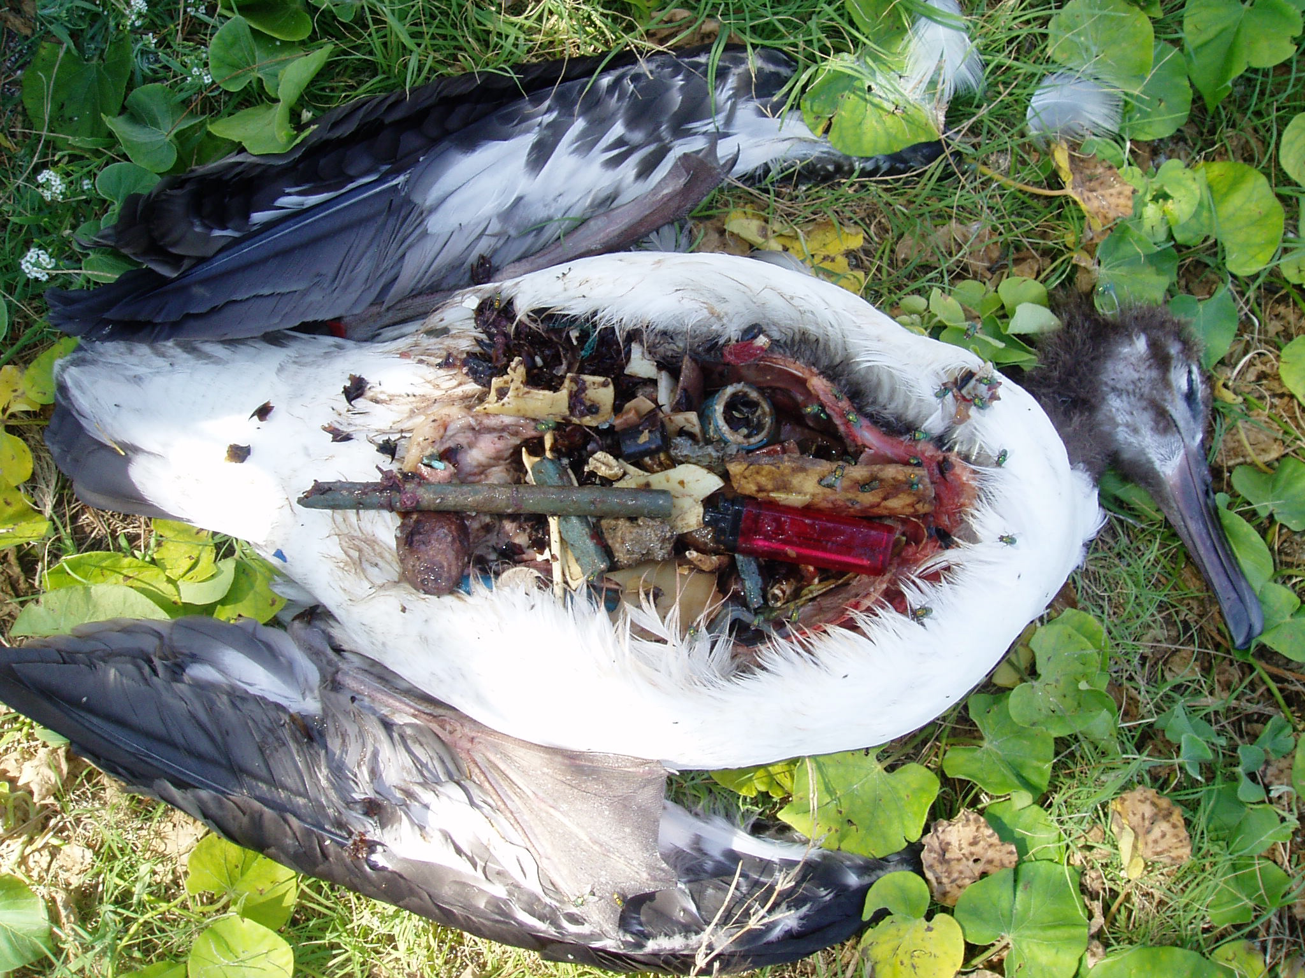
2| Problem
4 | Who experiences it?
Plastic pollution is killing our marine wildlife.
This leads to issues with ocean health, food safety, human health, climate change and the ecosystem.
In 2018-2019, only 15% of plastics estimated to be recycled or used for energy recovery. (National Waste Report 2020, p. 96)
Plastic consumption remains on an upward trajectory. WEF (2016) advises that global production of 15 Mt in 1964 grew to 311 Mt in 2014, is expected to double again by 2034 and almost quadruple by 2050.
Notes:
Ocean plastics affect marine wildlife and thus the entire food chain.
It contributes to environmental problems like climate change

Slide 6
2| Problem
5 | The Root Cause
Plastic is cheap, convenient and versatile, but cannot be fully recycled and reused
Plastic breaks apart, making it hard to stop small pieces getting into our waters/oceans
People want to help their environment, but it needs to be easy and beneficial to them
Notes:
The root causes are:
plastics cant be fully recycled and reused,
Its Hard to stop small plastics entering waters
Also, People want benefits and convenience

Slide 7
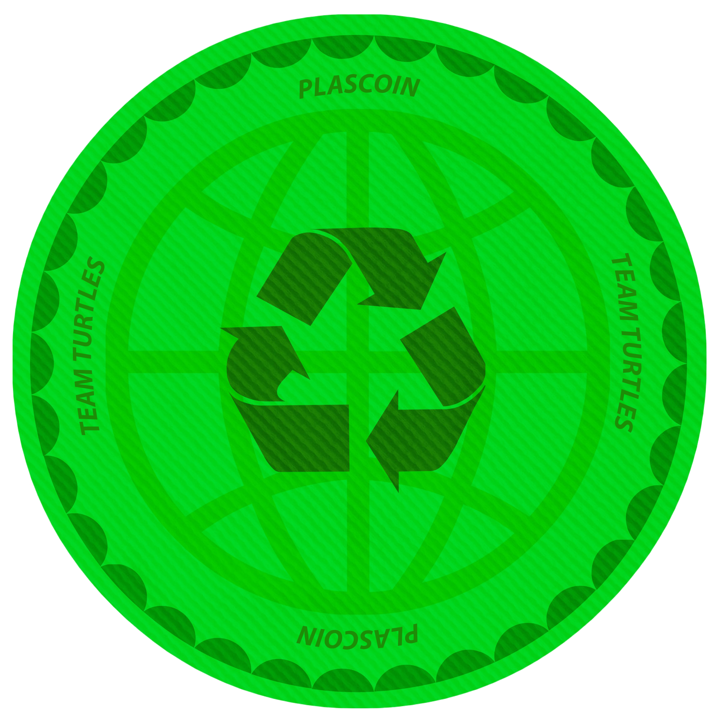
3| Solution
6 | Introducing...
”Your currency today for a better tomorrow”
Notes:
To counter the problem, we introduce you to plascoin

Slide 8
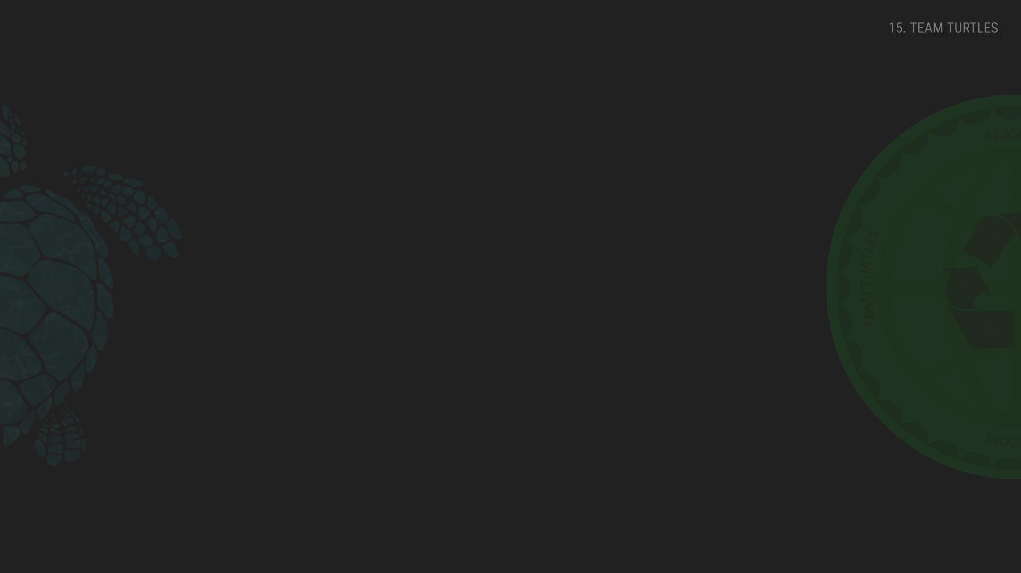
3| Solution
6.1 | Plascoin
A DIGITAL TOKEN - used as a measure of value and trust to exchange goods and services
RETURN TO EARN - Handing out plastic waste to tellers/drop off locations for it to be valued and get you paid
OPEN TO ALL - All demographics, races, etc. can use it
SECURE - Has policies, procedures and security features to safeguard our valued users
FUN FACT: Would help reduce the estimated plastic waste on oceans predicted for 2050
Notes:
a digital currency, which is gained by handing over plastic waste to drop off points and tellers in exchange for the digital currencies which can be used for day to day purchases.

Slide 9
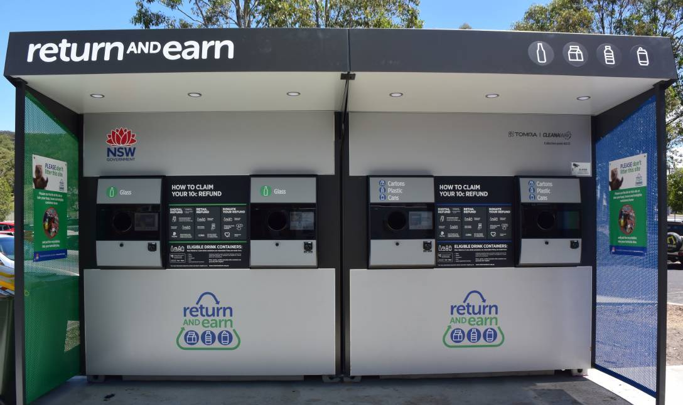

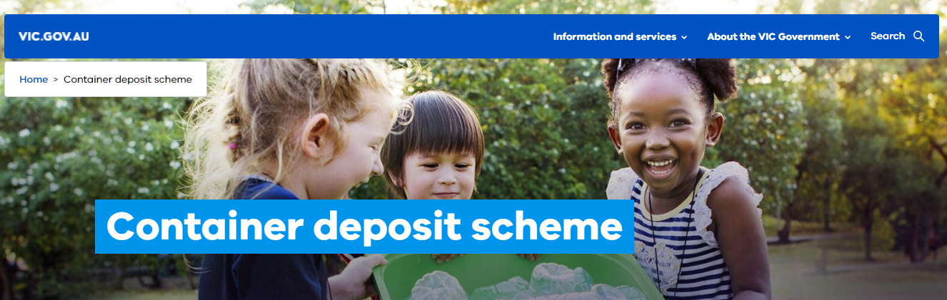
3| Solution
7.1 | Our competitors
Our Competitors
Notes:
our competitions are NSW's Return and earn and Victoria's container deposit scheme but what makes us stand out is

Slide 10
3| Solution
7.2 | How we stand out
BREAKING LIMITATIONS - Focus on plastic considered as “Non-recyclable” in addition to recyclable plastic.
PLASCOIN ACCOUNT BALANCES - Individuals can maintain online account to keep track of their Plascoin balance
REWARDS - A system to encourage individuals to help reach our goals
EXTERNAL SUPPORT - Working with local supermarkets/organisations to connect everyone to the cause
FUN FACT: Plascoin could also potentially aim to contribute to other SDGs such as, zero hunger, no poverty, life on land, etc
Notes:
that, we have a broader focus on plastics handed over. we manage online accounts for users, provide rewards and hope to work with external parties such as restaurants

Slide 11
3| Solution
8 | How is Plascoin sustainable?
Virtual reward system, no physical item to manufacture
Earning credits are a symbol of achievement
Advanced by Waves of Plastic Clean-up Heroes who can’t be stopped!
Notes:
Its a virtual, non-degrading system, makes users feel fulfilled, and it creates an unstoppable movement

Slide 12
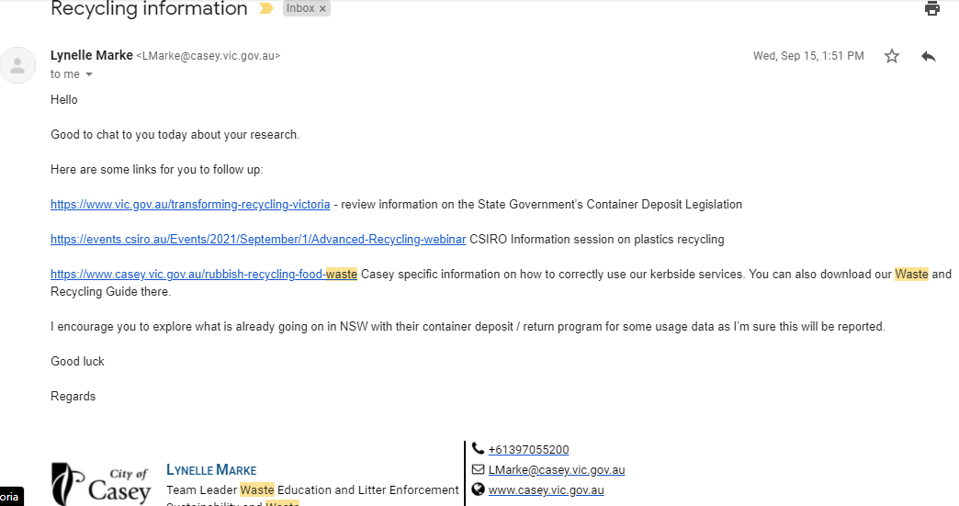
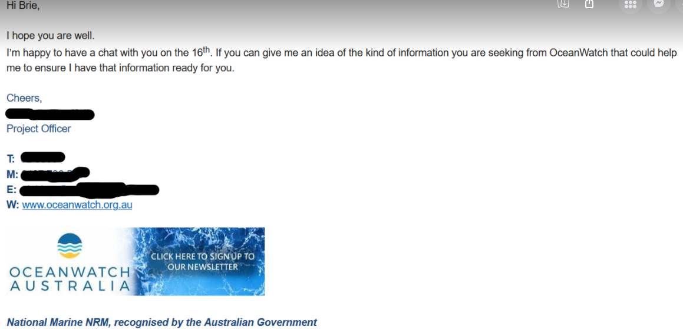
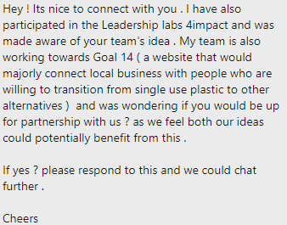
4| Progress
9 | Our Journey so far
Brainstorming ideas
Agreeing upon best solution
Contact with some organizations and Victoria Council
Thinking up a way to bring forward movement
Checking upon socials for feedback and impact
Currently, pitching it
Notes:
Our journey so far includes brainstorming ideas to come up with best solutions, contacting organisations, councils and individuals for feedback and criticism, etc. as you can see in the slide itself.

Slide 13
5| Future
10 | Our plans growing
Create the machines which can scan and weigh plastic waste
Partnering-up with credit companies / banks to develop rewards system
Team up with government recycling companies to develop recycling plan and logistics
Continue to refine and develop to ensure continued success
Notes:
Our plan is to build the machines that value the plastic waste
Partner up with organisations to develop reward systems, recycling plans, etc.
We also plan to further develop this concept for a guaranteed success

Slide 14
References
For your interests
Joe Pickin, Christine Wardle, Kyle O’Farrell, Piya Nyunt, Sally Donovan, “National Waste Report 2020”, 2020, p. 96. https://www.environment.gov.au/system/files/pages/5a160ae2-d3a9-480e-9344-4eac42ef9001/files/national-waste-report-2020.pdf
United Nations, Goal 14: Conserve and Sustainably use the oceans marine resources”, https://www.un.org/sustainabledevelopment/oceans/

Slide 15
THANK YOU!

